Slide 1

WEATHER PREDICTOR
RUDRAKSH SINGH E22CSEU0010,
HARSH YADUWANSHI E22CSEU0021,
KEERTHI THORAT E22CSEU1442

Slide 2


WEATHER PREDICTOR
Weather prediction is a challenging task that involves forecasting the future state of the atmosphere. Ensemble methods are a powerful tool for weather prediction, as they can combine the predictions of multiple models to improve accuracy.

Slide 3





LIBRARIES AND ALGORITHMS USED
libaries used
algorithm used
NumPy
Pandas
Matplotlib
Scikit-Learn
Seaborn
XGBoost
Support Vector Machines (SVM)
K-Nearest Neighbors (KNN)
Gradient Boosting

Slide 4
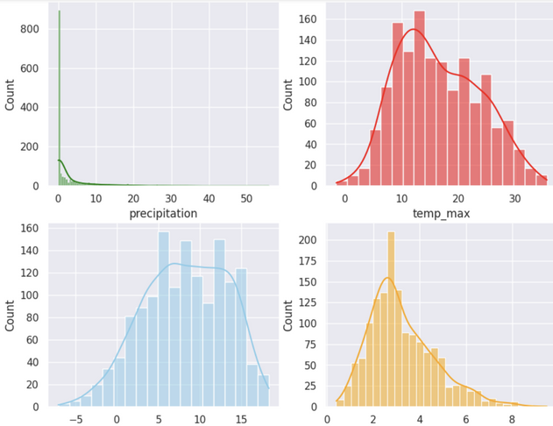
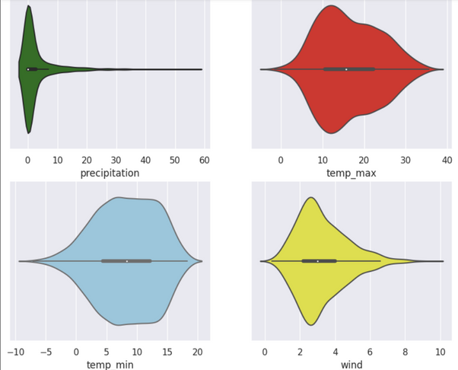
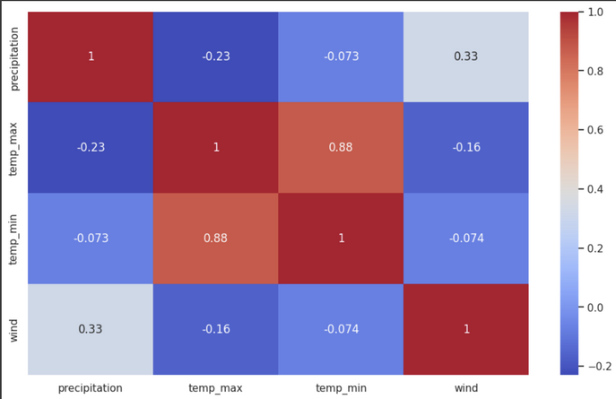
DATA
ANALYSIS

Slide 5
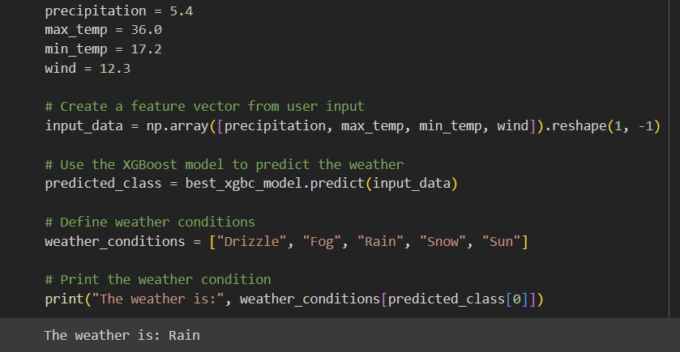
RESULT
After model is trained result varies based upon data input by the user

